Slide 1


Computational Intelligence (TC2027)

Slide 2
Unit 4 – Network Security (I)
Network Security Architecture Design
Firewall Introduction
Zone Security Architecture

Slide 3
Network Security Architecture Design

Slide 4
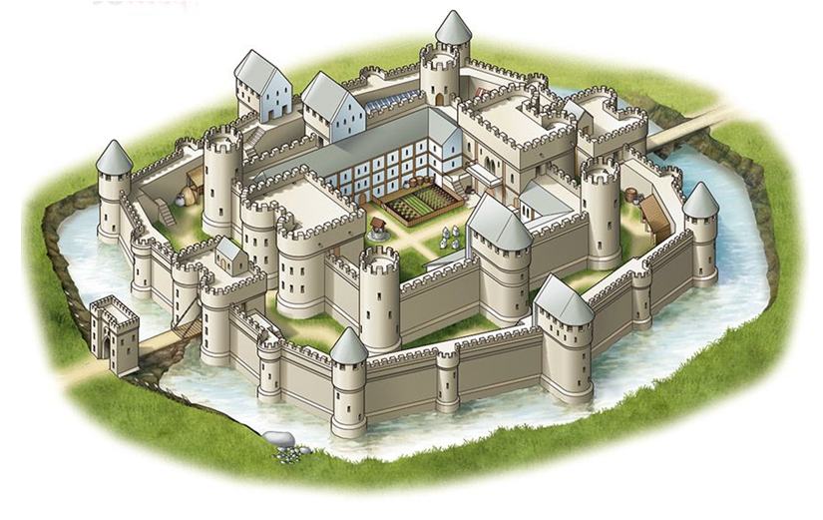
Basis of Network Architecture Security Design
Compared to security architecture to a castle, network security is equivalent, as it is based on the development of an Internet perimeter firewall with an outside and an inside.
The protection is based multiples layers of security.

Slide 5
Fundamentals Principles
Isolation, Separation, Compartmentalization
Policy Enforcement
Identity and Trust
Instrumentation and Visibility
Correlation
Resilience

Slide 6
Isolation, Separation, Compartmentalization
Ensure that the effects of a disturbance, or an incident, within one part of a system, can be limited to just that part of the overall system.
Through the use of isolation, disturbances or incidents within one part of the overall system can have minimal impact on other users, services, or sub-systems.
Examples: VLANs, Virtual Routers, tunneling techniques, and Security Zones.

Slide 7
Policy Enforcement
Provides the ability to enforce allowed behavior between connected systems, users, applications, IP networks, subnets, or endpoints.
Examples: Access Control Lists (ACLs), firewall rules, application control, and file blocking policies.
Identity and Trust
defines the ability of a system to identify entities accessing a given resource and determine a trust level or a state of trust.
Examples: username and password credentials, digital certificates, multi‐factor authentication, trusted IP addresses or ranges.

Slide 8
Instrumentation and Visibility
Monitor the behavior and usage of the network including its resources, connected systems, user, applications, IP traffic, and any directly detected security events.
Correlation
Provides the interpretation and dissemination, analysis and classification of instrumentation and visibility data into meaningful operational information via the contextualization of seemingly unrelated events, changes or traffic patterns.
Resilience
Provides the ability of an architecture to withstand, adjust to and/or recover from adverse, uncontrolled, or unexpected circumstances.
Example: redundancy, high-­‐availability device pairs or clusters, and adequate performance profiles.

Slide 9
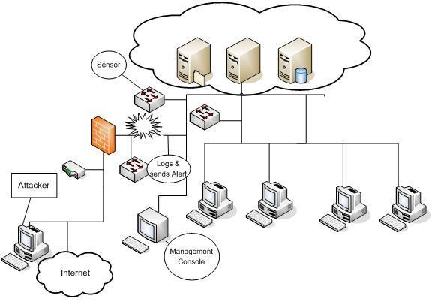
Passive System
Detects a potential security breach
Logs the information
Signals an alert on the console
Does not take any preventive measures to stop the attack

Slide 10
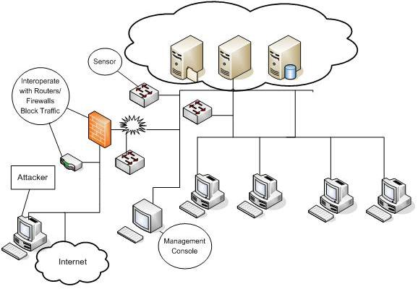
Reactive/Active Systems
Responds to the suspicious activity like a passive IDS by logging, alerting and recording, but offers the additional ability to act against the offending traffic.

Slide 11
Firewall Introduction

Slide 12
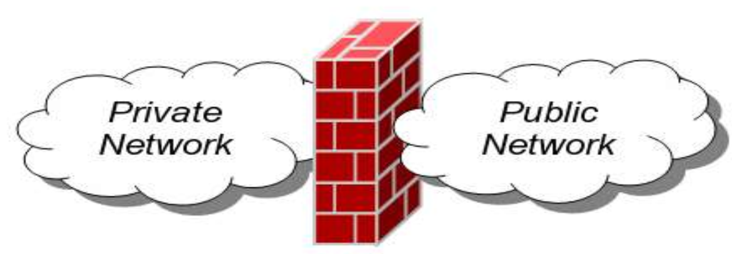
Firewall
A Network Firewall is a system or group of systems used to control access between two networks: a trusted network and an untrusted network using pre-configured rules or filters.

Slide 13
Firewall
Firewall is device that provides secure connectivity between networks (internal/ external).
It is used to implement and enforce a security policy for communication between networks.
All messages entering or leaving the intranet pass through the firewall, which examines each message & blocks those that do not meet the specified security criteria

Slide 14

What is a Firewall?
Notes:
https://www.youtube.com/watch?v=kDEX1HXybrU

Slide 15
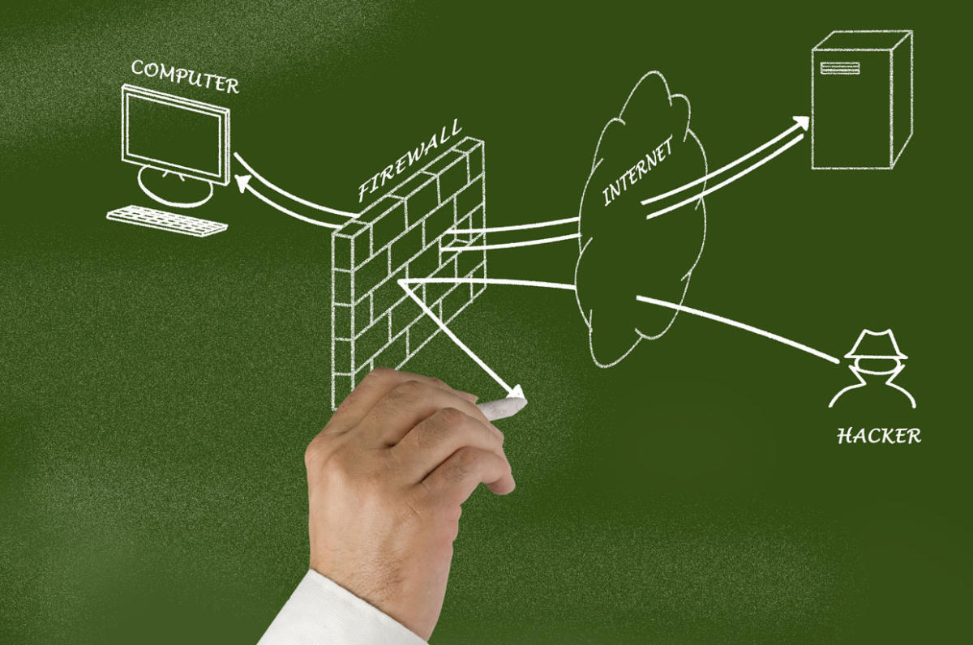
Functions of Firewall
Routing and Switching
Network Address Translation / Network Port Translation
Stateful / Deep Inspection
High Speed Logging
Port Randomizing
Virtual Private Network

Slide 16
Additional Functions of Firewall (NextGen)
Application Detection
Application Control
Control of Application Groups based on type, tag, category, risk rating, etc
SSL/TLS Decryption
User Identification
Compound policy based on multiple parameters (i.e. allow/block apps by user)
File blocking
Geolocation
Context between the above capabilities

Slide 17
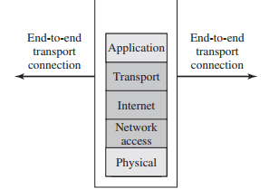
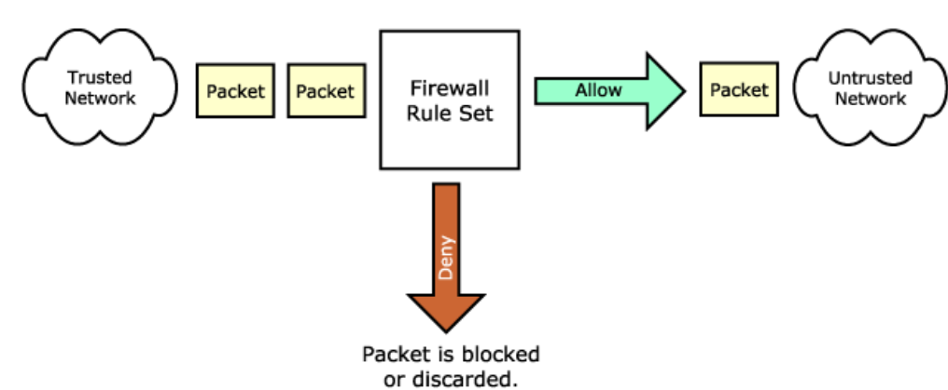
Firewall Technics - Packet Filter
Packet Filter looks at each packet entering or leaving the network and accepts or rejects it based on user-defined rules.
Packet filtering is effective & transparent to users, but it is difficult to configure.
In addition, it is susceptible to IP spoofing.

Slide 18
Packet Filter - Stateful Packet Inspection (SPI)
working at the network and transport layers and examining each network packet’s header and footer without touching the packet context.
This approach maintains state on previous packets received, and hence can associate newly received packets with previously seen packets.
SPI systems can know whether a packet is part of a handshake to establish a new connection, a section of an existing network connection, or an unexpected rogue packet.
Useful in detecting slightly more complex layer 3/4 attacks such as IP spoofing, TCP/IP attacks (such as ARP cache poisoning or SYN flooding), and denial-of-service (DOS) attacks.

Slide 19
Packet Filter - Deep Packet Inspection (DPI)
DPI is the process of examining the data encapsulated in network packets, in addition to the headers and footers (application layer).
DPI can collect signals that can help detect spam, malware, intrusions, and subtle anomalies.
Real-time streaming DPI is a challenging computer science problem because of the computational requirements necessary to decrypt, disassemble, and analyze packets going through a network intersection.
One thing you can do is to detect suspicious activity in web applications by inspecting the strings present in the POST body of HTTP requests.

Slide 20
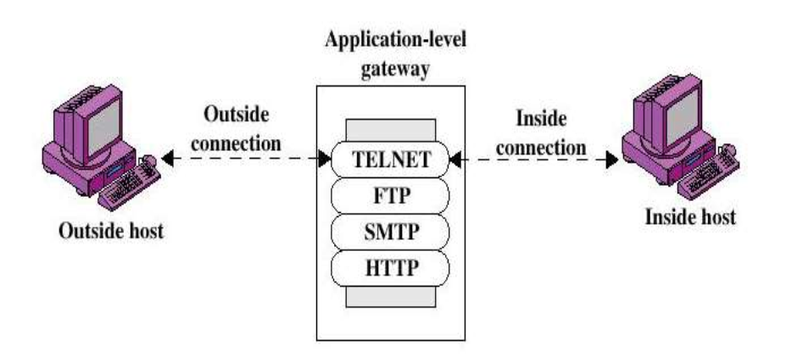
Firewall Technics – Application Gateway
In such type of firewall remote host or network can interact only with proxy server, proxy server is responsible for hiding the details of the internal network (ex.: intranet).
Users uses TCP/IP application, such as FTP & Telnet servers.
This is very effective but can impose a performance degradation.

Slide 21
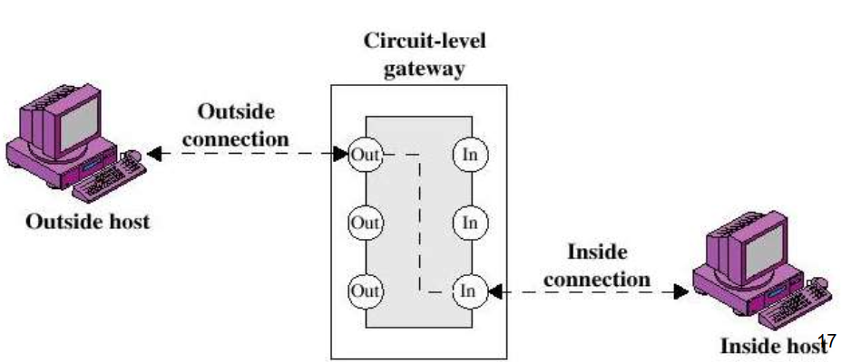
Firewall Technics – Circuit Level Firewalls
This can be a standalone system, or it can be a specialized functions performed by an application – level gateway for certain applications.
It does not permit an end-to-end TCP connection; rather, the gateway sets two TCP connections.
A typical use of the circuit-level gateway is a situation in which the system administrator trusts the internal users.

Slide 22
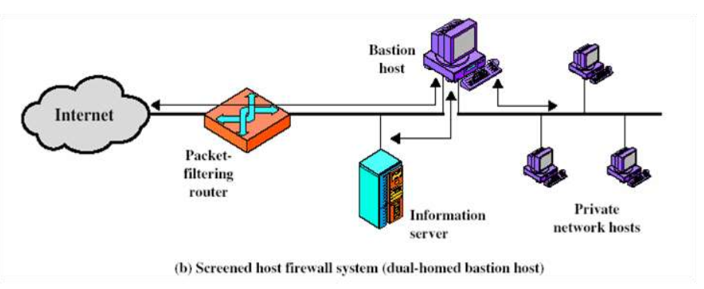
Firewall Technics – Bastion Host
Bastion host is a special purpose computer on a network specifically designed and configured to withstand attacks.
It generally hosts a single application, provides platform for application gateway and circuit-level gateway.
It supports limited/specific applications to reduce the threat to the computer.

Slide 23
Zone Security Architecture

Slide 24
Zone Security
A network segment, also known as a network security zone, is a logical grouping of information systems in an enterprise network.
An enterprise network is divided into manageable network segments to reduce the scope of compliance, limit data exfiltration, and reduce the attack surface.
A network security zone has a well-defined perimeter and strict boundary protection, and the systems within it are susceptible to similar types of cyber threats*.
Baseline Security Requirements for Network Security Zones in the Government of Canada | Communications Security Establishment. (n.d.). Retrieved from https://www.csecst.gc.ca/en/node/268/html/15236

Slide 25
Zone Security
https://us-cert.cisa.gov/ics/Secure-Architecture-Design-Definitions
Demilitarized zone (DMZ)* or perimeter network is a network area (a subnetwork) that sits between an internal network and an external network.
The point of a DMZ is that connections from the internal and the external network to the DMZ are permitted, whereas connections from the DMZ are only permitted to the external network - hosts in the DMZ may not connect to the internal network.
This allows the DMZ's hosts to provide services to the external network while protecting the internal network in case intruders compromise a host in the DMZ. For someone on the external network who wants to illegally connect to the internal network, the DMZ is a dead end.
The control system authentication DMZ is used for providing corporate network user authentication for internal control system network access.

Slide 26
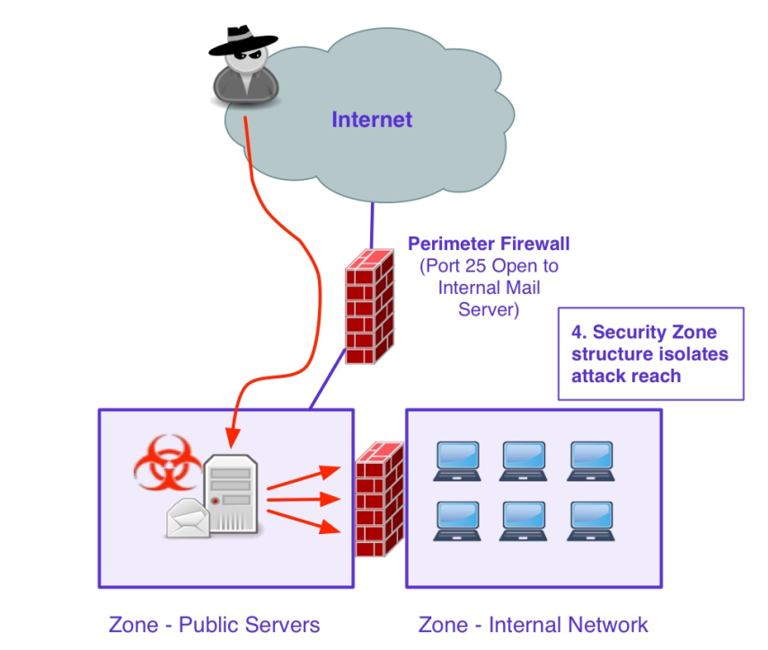
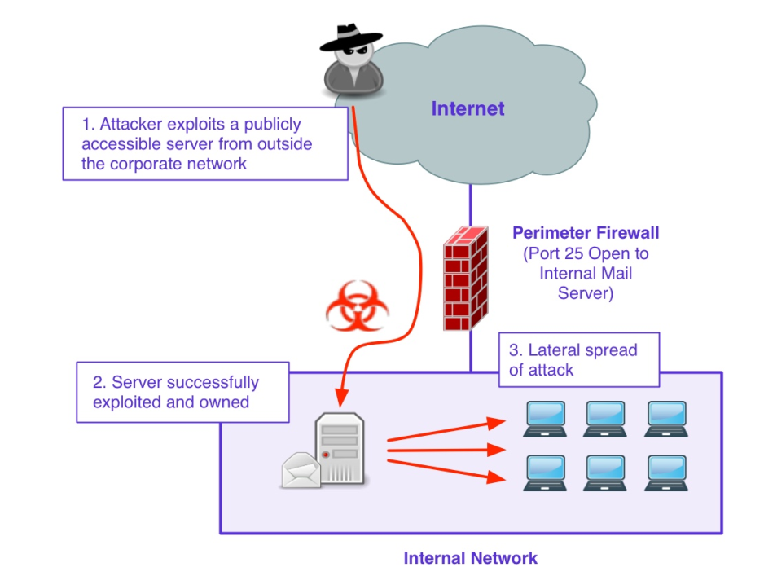
An Open Internal Architecture
A Compartmentalized Architecture

Slide 27
General Security Guidelines to Zone Design
Identification and classification of groups of systems and resources
Each zone has one discrete point of entry defined by a stateful inspection firewall
Only business required traffic is allowed to leave or enter a zone
Inbound and outbound zone traffic is filtered and monitored at the perimeter
Establishing a small number of network security zones with clearly defined security requirements limits the complexity and removes ambiguity when selecting a zone for new systems while meeting most business requirements.

Slide 28
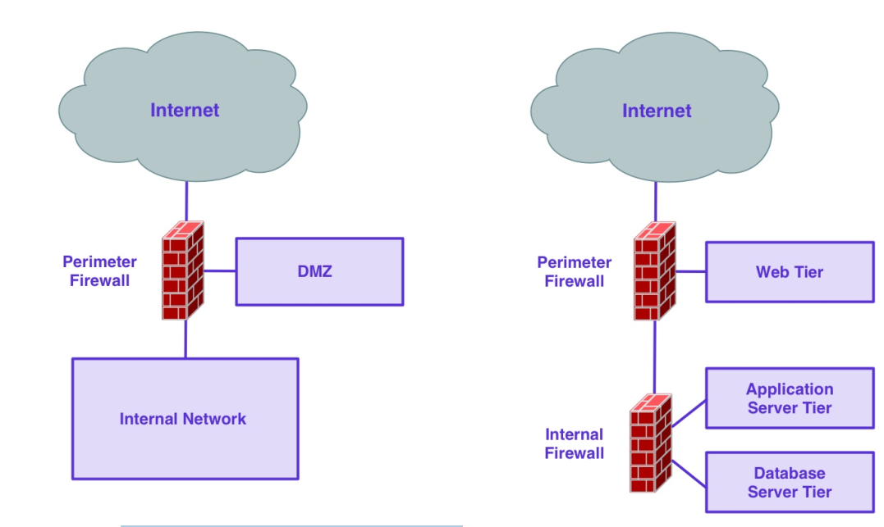
Classic zoned security architectures

Slide 29
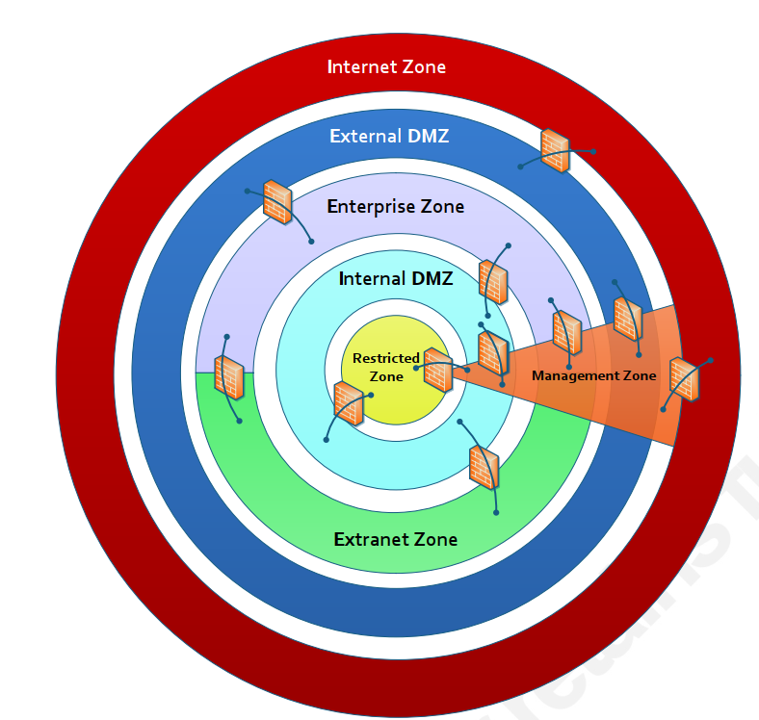
Types of DMZ
Internet Zone - No Trust
External DMZ - Low Trust
Enterprise Zone - Medium Trust
Extranet Zone - Medium Trust
Internal DMZ - High Trust
Management Zone - Highest Trust
Restricted Zone - Highest Trust
Baseline Security Requirements for Network Security Zones in the Government of Canada | Communications Security Establishment. (n.d.). Retrieved from https://www.csecst.gc.ca/en/node/268/html/15236

Slide 30

Internet Zone
Internet, the Public Switched Telephone Network (PSTN), and any Internet Service Provider (ISP) public backbone networks
The Internet Zone is the least trusted zone.
It is an extremely inhospitable zone where anonymous threat actors live.
This zone is typically outside of the control of the organization.

Slide 31

External DMZ
The External DMZ houses systems that require exposure to the Internet.
This zone proxies' access between systems in the Enterprise Zone and the Internet.
Services: External web servers, E-mail gateways, FTP servers, Web proxy servers, and Remote access services.

Slide 32
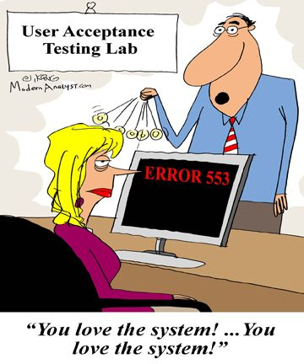
Enterprise Zone
The Enterprise Zone is where end-user systems reside, including end-user workstations, printers, and VoIP Phones.
Endpoint protection is a critical control in this zone to limit the exposure of end-user systems to malware

Slide 33

Extranet Zone
The Extranet Zone houses connections with highly trusted 3rd party business partners and can be an extension of the Enterprise Zone.
Nonetheless, it is recommended that traffic between the Enterprise and Extranet Zones is monitored and filtered at the zone's perimeter to allow only business approved traffic to enter and leave the zone.

Slide 34

Internal DMZ
The Internal DMZ mediates access between systems in the Enterprise/Extranet Zones and Restricted Zone.
Internal application servers typically live in this zone.
End-users must authenticate before gaining access to the data hosted in the Restricted Zone.

Slide 35

Management Zone
The Management Zone houses administration and monitoring systems such as performance servers, configuration management servers, log management servers, jump hosts, and security management systems.
Systems in this zone are prime targets of attacks given their ability to access any other zone in the enterprise. Users of systems in this zone have higher privileges that allow them to perform their job duties

Slide 36

Restricted Zone
The Restricted Zone houses business-critical systems and large repositories of sensitive information.
A breach of confidentiality, integrity, or availability of any system in this zone could negatively impact an organization's competitive advantage, reputation, or share price.
This zone should have the highest level of protection to ensure that those attacks that are most likely to succeed against the systems within are detected.

Slide 37
Unit 4 – Network Security (I)
Network Security Architecture Design
Firewall Introduction
Zone Security Architecture

Slide 38
Computational Intelligence (TC2027)

